Slide 1
Plant Assets, Natural Resources, and Intangible Assets

Slide 2
DECLINING-BALANCE
Decreasing annual depreciation expense over the asset’s useful life
Periodic depreciation is based on a *declining book value
(cost - accumulated depreciation)
To compute annual depreciation expense
Multiply the book value at the beginning of the year by the declining-balance depreciation rate
Depreciation rate remains constant from year to year
book value declines each year

Slide 3
DECLINING-BALANCE
Book value for the first year is the cost of the asset.
Balance in accumulated depreciation at the beginning of the asset’s useful life is zero
In subsequent years, book value is the difference between cost and accumulated depreciation at the beginning of the year.
Formula for computing depreciation expense:
Book Value at Beginning of Year x Declining Balance Rate = Annual Depreciation Expense
Method compatible with the matching principle
the higher depreciation in early years is matched with the higher benefits received in these years.

Slide 4
FORMULA FOR DECLINING-BALANCE METHOD
Unlike the other depreciation methods, salvage value is ignored in determining the amount to which the declining balance rate is applied.
A common application of the declining-balance method is the double-declining-balance method, in which the declining-balance rate is double the straight-line rate.
If Barb’s Florists uses the double-declining-balance method, the depreciation is 40% (2 X the straight-line rate of 20%).
Depreciable
Cost per Unit
Units of
Activity during the Year
Annual Depreciation Expense
=
$13,000 x 40% = $5,200

Slide 5
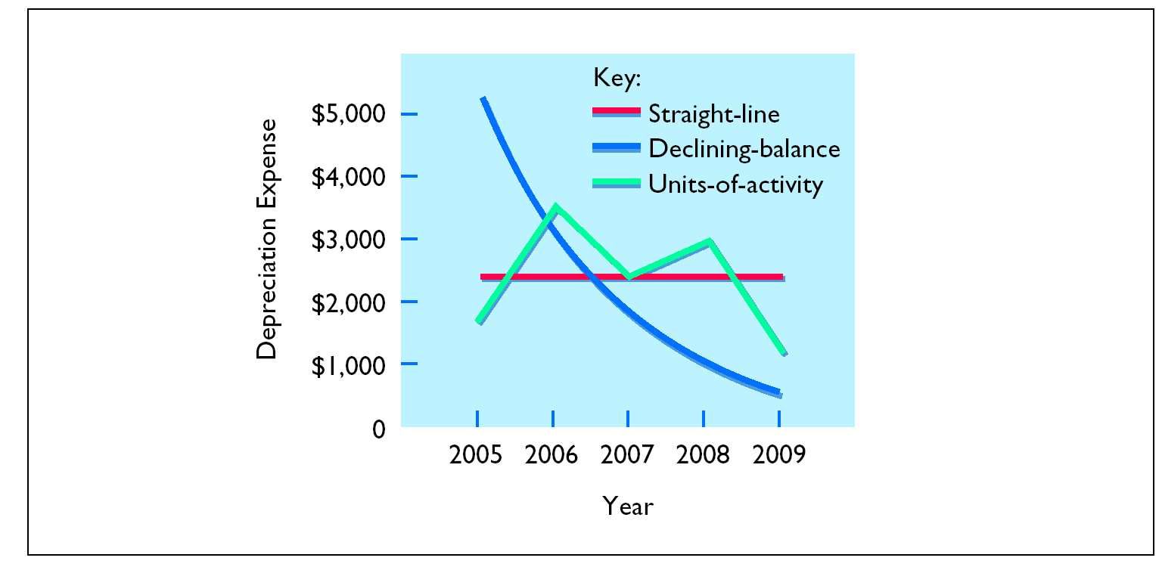
PATTERNS OF DEPRECIATION

Slide 6
REVISING PERIODIC DEPRECIATION
STUDY OBJECTIVE 4
Changes should be made
Excessive wear and tear or obsolescence indicate that annual depreciation estimates are inadequate.
When a change is made
No correction of previously recorded depreciation expense
Depreciation expense for current and future years is revised
To determine the new annual depreciation expense
The depreciable cost at the time of the revision is divided by the
remaining useful life.

Slide 7
REVISED DEPRECIATION COMPUTATION
Barb’s Florists decides on January 1, 2008, to extend the useful life of the truck one year because of its excellent condition. The company has used the straight-line method to depreciate the asset to date, and book value is $5,800 ($13,000 - $7,200). The new annual depreciation is $1,600, calculated as follows:
Book value, 1/1/08
$5,800
Less: Salvage value
1,000
Depreciable cost
$4,800
Remaining useful life
3 years
(2008-2010)
Revised annual depreciation ($4,800 ÷ 3)
$1,600

